Slide 1
Smart Home Energy Advisor Agent
IBM HACKATHON PROJECT
Presented By:
Student name : Mansee Dakhole
College Name & Department : Symbiosis Institute of Technology Nagpur

Slide 2
OUTLINE
Problem Statement
Technology used
Wow factor
End users
Result
Conclusion
Git-hub Link
Future scope
IBM Certifications

Slide 3
Problem Statement
A Smart Home Energy Advisor Agent acts like your personal electricity manager. It takes information from your smart meter and appliances, analyzes power usage, and gives you tips to save energy. The agent can answer questions like "Why is my bill so high this month?" or "What time should I run the washing machine to save money?". It uses AI to understand consumption patterns and provide simple recommendations.

Slide 4
Technology used
IBM Cloud Lite Services – Platform where the Smart Home Energy Advisor Agent is built and deployed
Watsonx.ai Agent – Used to create, configure, and run the AI-based energy advisor
Natural Language Processing (NLP) – To process user queries and generate meaningful answers
Retrieval-Augmented Generation (RAG) – To combine model intelligence with uploaded dataset for relevant responses
Mistral-large Mode – Foundation model used for reasoning and recommendations

Slide 5
IBM cloud services used
IBM Cloud Watsonx AI Studio – Environment for creating and managing AI agents, prompts, and datasets
IBM Cloud Watsonx AI Runtime – Execution runtime for running AI models and serving responses to user queries
IBM Cloud Agent Lab – Tool for building, testing, and refining AI agents using foundation models and custom data
IBM Mistral-large Foundation Model– AI foundation model used for reasoning, energy consumption analysis, and recommendations

Slide 6
Wow factors
This agent will help households reduce electricity bills by analyzing usage patterns and suggesting cost-saving strategies.
It will save time by automatically identifying high-consumption appliances and optimal usage schedules.
It makes energy optimization accessible for non-technical users through natural language interaction.
It encourages energy efficiency and sustainability, indirectly supporting environmental goals.
Unique Features – Detects high energy consumption trends from usage data.
Peak Hour Optimization – Suggests best time slots to run appliances for cost savings.
Appliance-Level Insights – Identifies which appliances contribute most to the bill.
Smart Recommendations – Offers tailored tips to reduce electricity usage and cost.
Bill Explanation – Answers queries like “Why is my bill high this month?” in simple terms.

Slide 7
End users
Homeowners & Residents – People looking to reduce their electricity bills and optimize energy usage.
Smart Home Enthusiasts – Users who want AI-based insights for appliance usage and energy efficiency.
Energy Service Providers – Companies interested in offering AI-driven energy advisory services.
Sustainability Advocates & NGOs – Organizations promoting energy conservation and sustainable living.

Slide 8
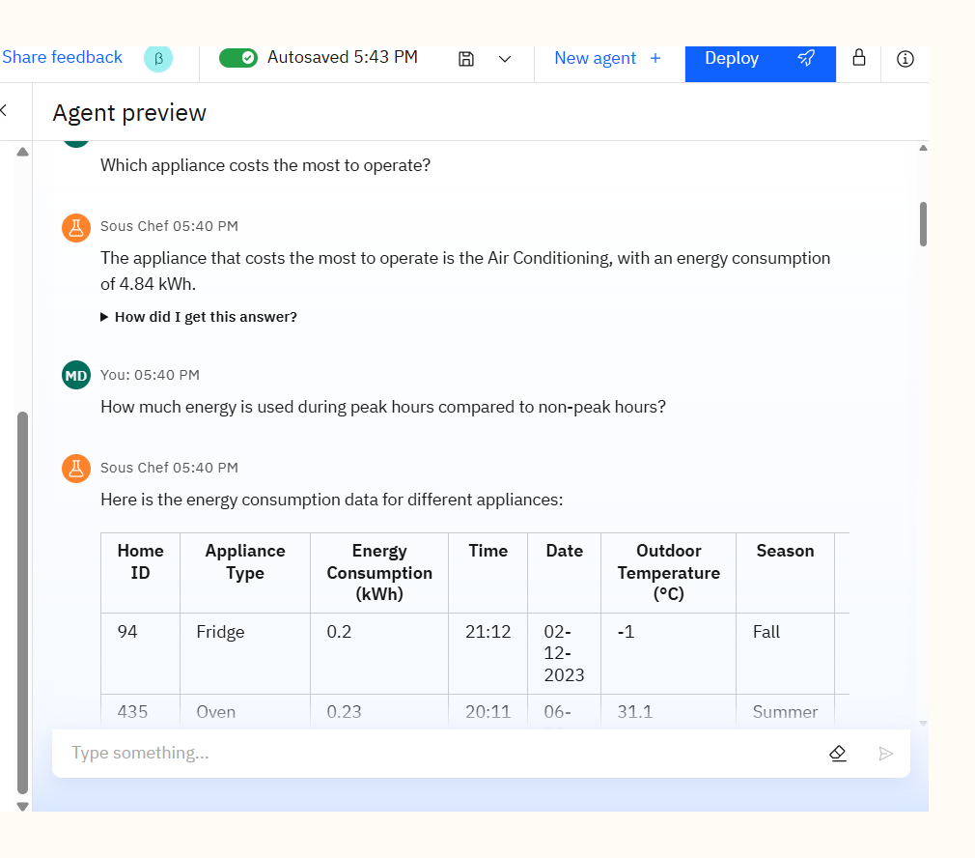
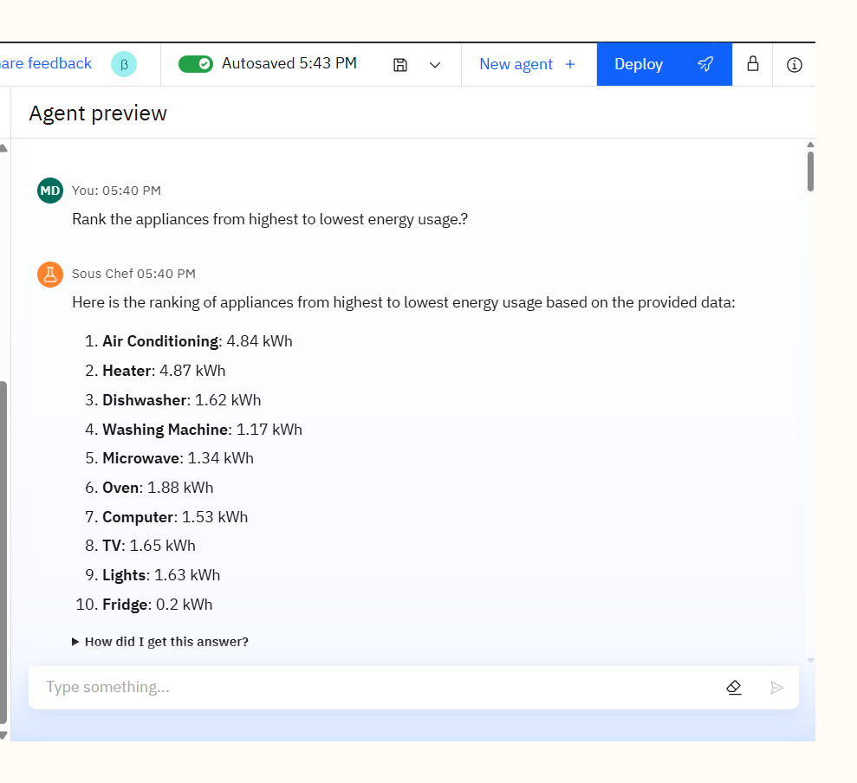
Results

Slide 9
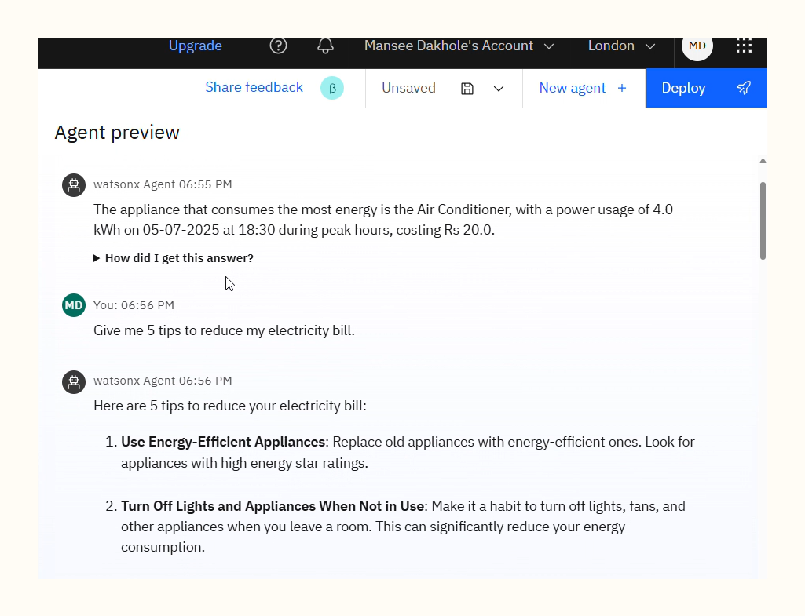
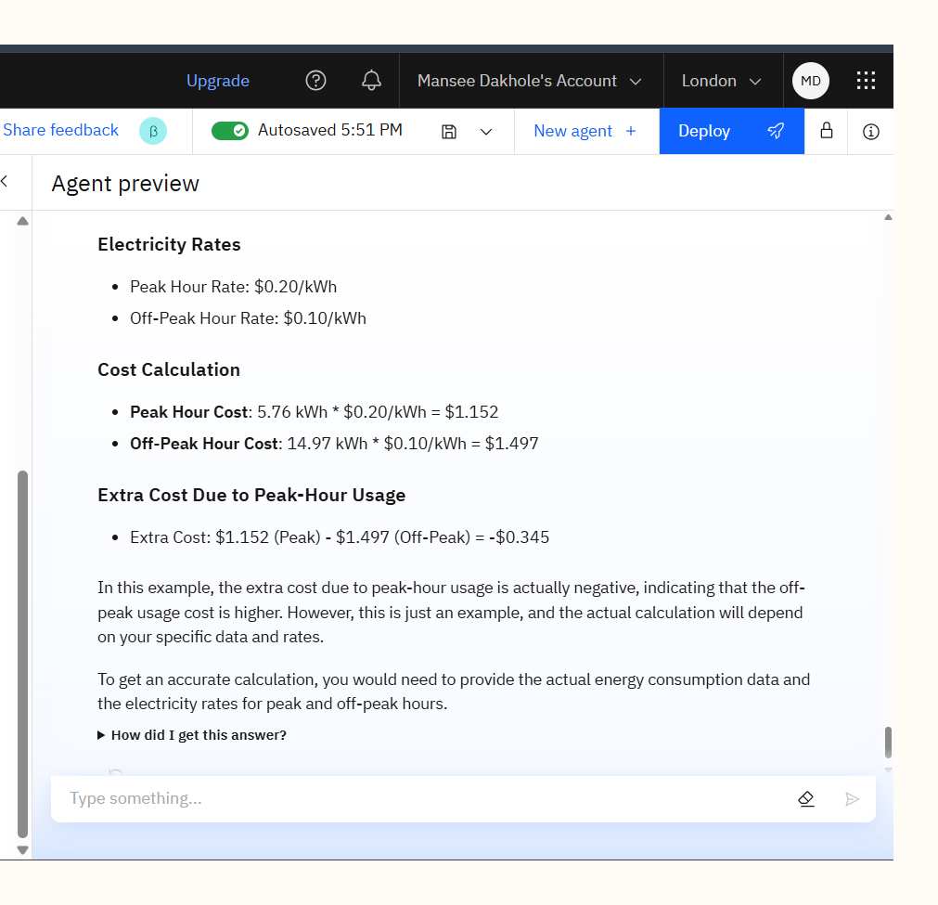
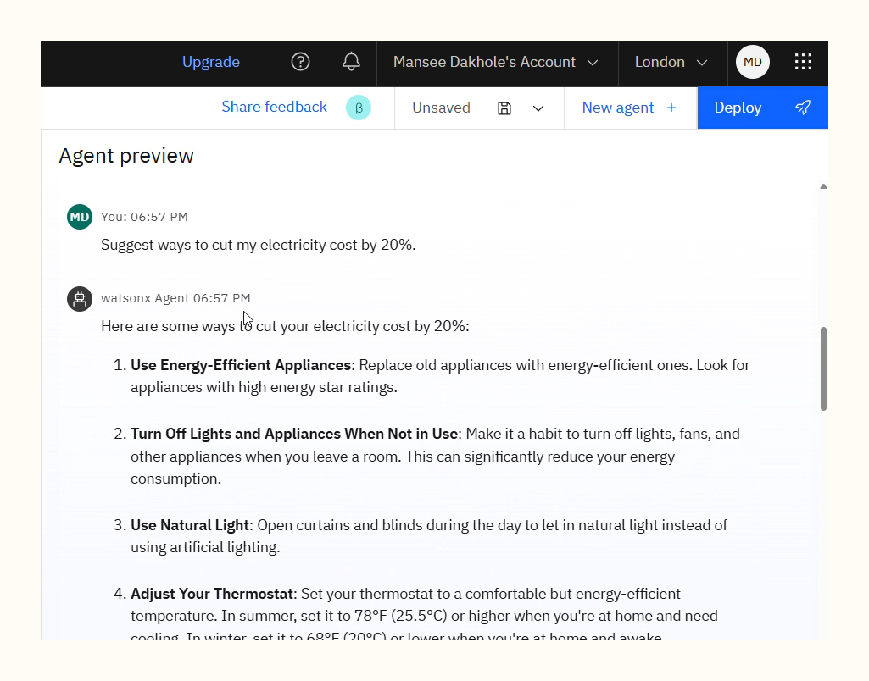
Results

Slide 10
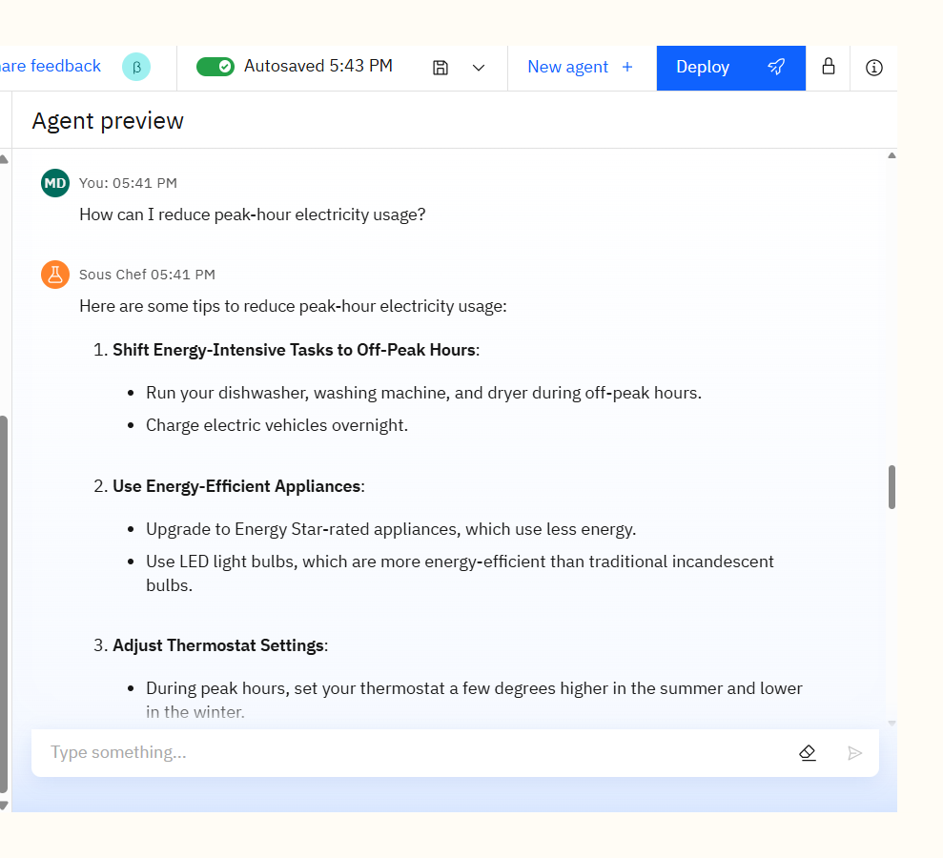
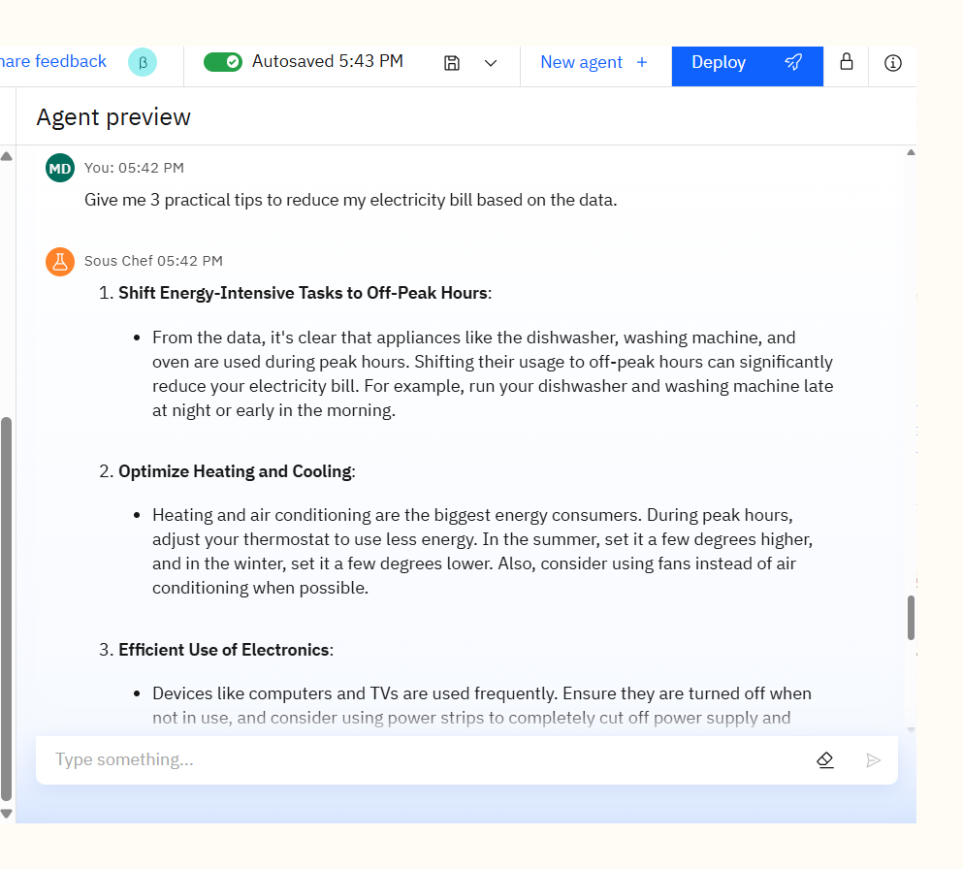
Results

Slide 11
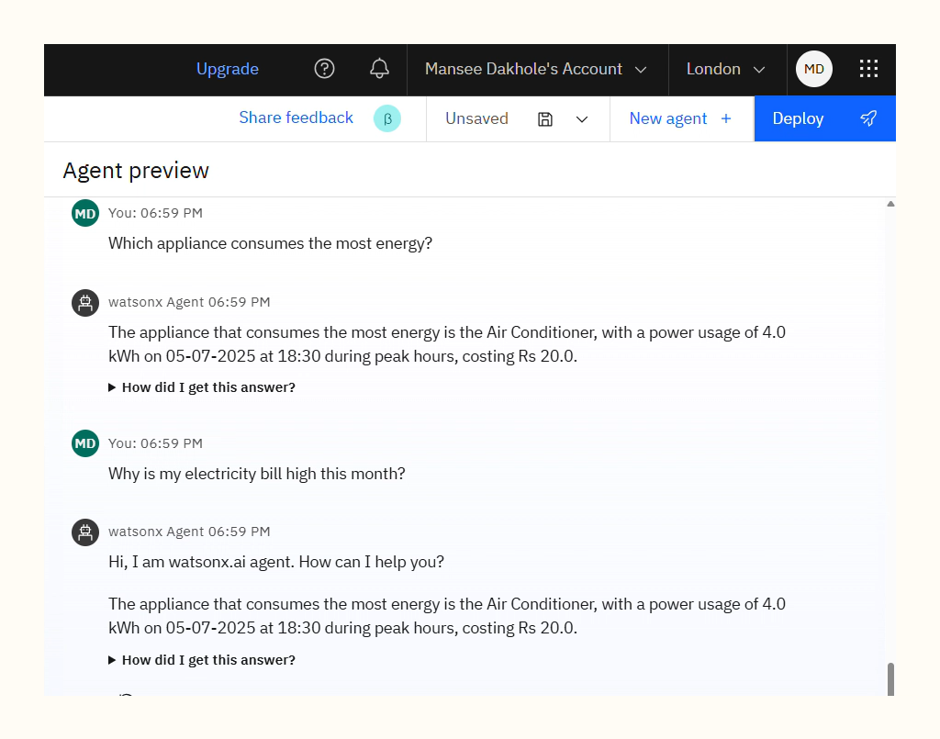
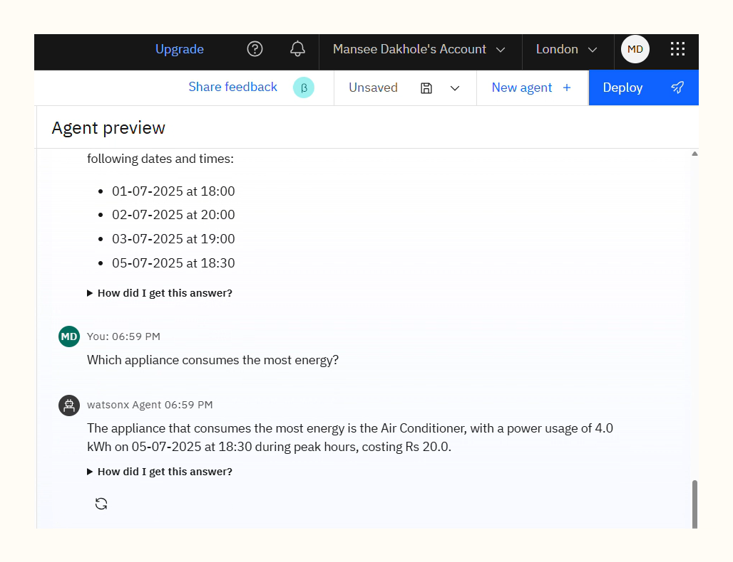
Results

Slide 12
Conclusion
Generates energy usage reports with clear insights.
Provides actionable strategies to reduce electricity costs.
Saves time by automating data analysis for users.
Enhances efficiency, accuracy, and sustainability in energy usage.
Provides cost-saving strategies based on user-specific energy data.
Supports long-term bill reduction through optimized appliance usage.

Slide 13
GitHub Link
https://github.com/Mansee-Dakhole/INTERNSHIP-EDUNET-IBM-CLOUD.git

Slide 14
Future scope
Multilingual Support – Expand the agent to provide energy insights in multiple languages for diverse users.
Voice-Activated Assistance – Integrate voice commands to make the agent accessible via smart speakers and mobile devices.
Real-Time Monitoring – Connect with live smart meters and IoT devices for continuous energy tracking.
Personalized Energy Goals – Suggest monthly energy-saving targets and track progress automatically.
Integration with Utility Platforms – Link directly with electricity providers for real-time tariff updates.
Mobile App Integration – Provide instant notifications, bill alerts, and energy-saving tips via a smartphone app.

Slide 15
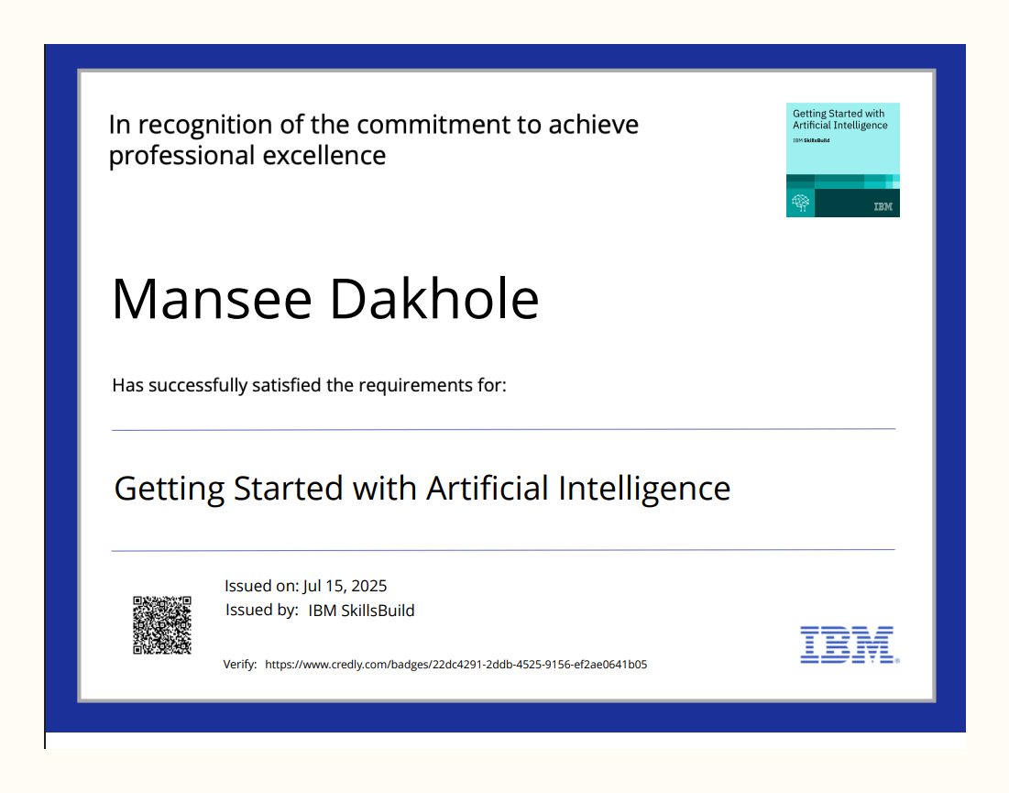
IBM Certifications

Slide 16
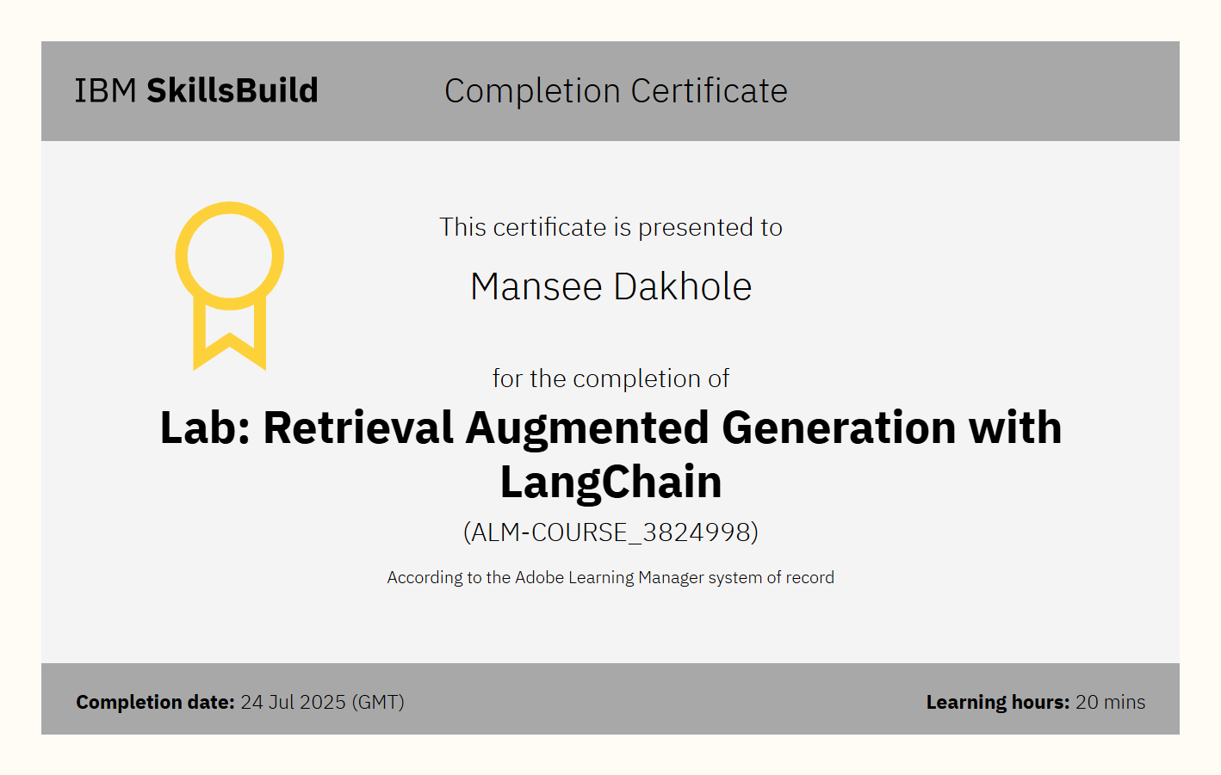

Slide 17
THANK YOU

